Slide 1
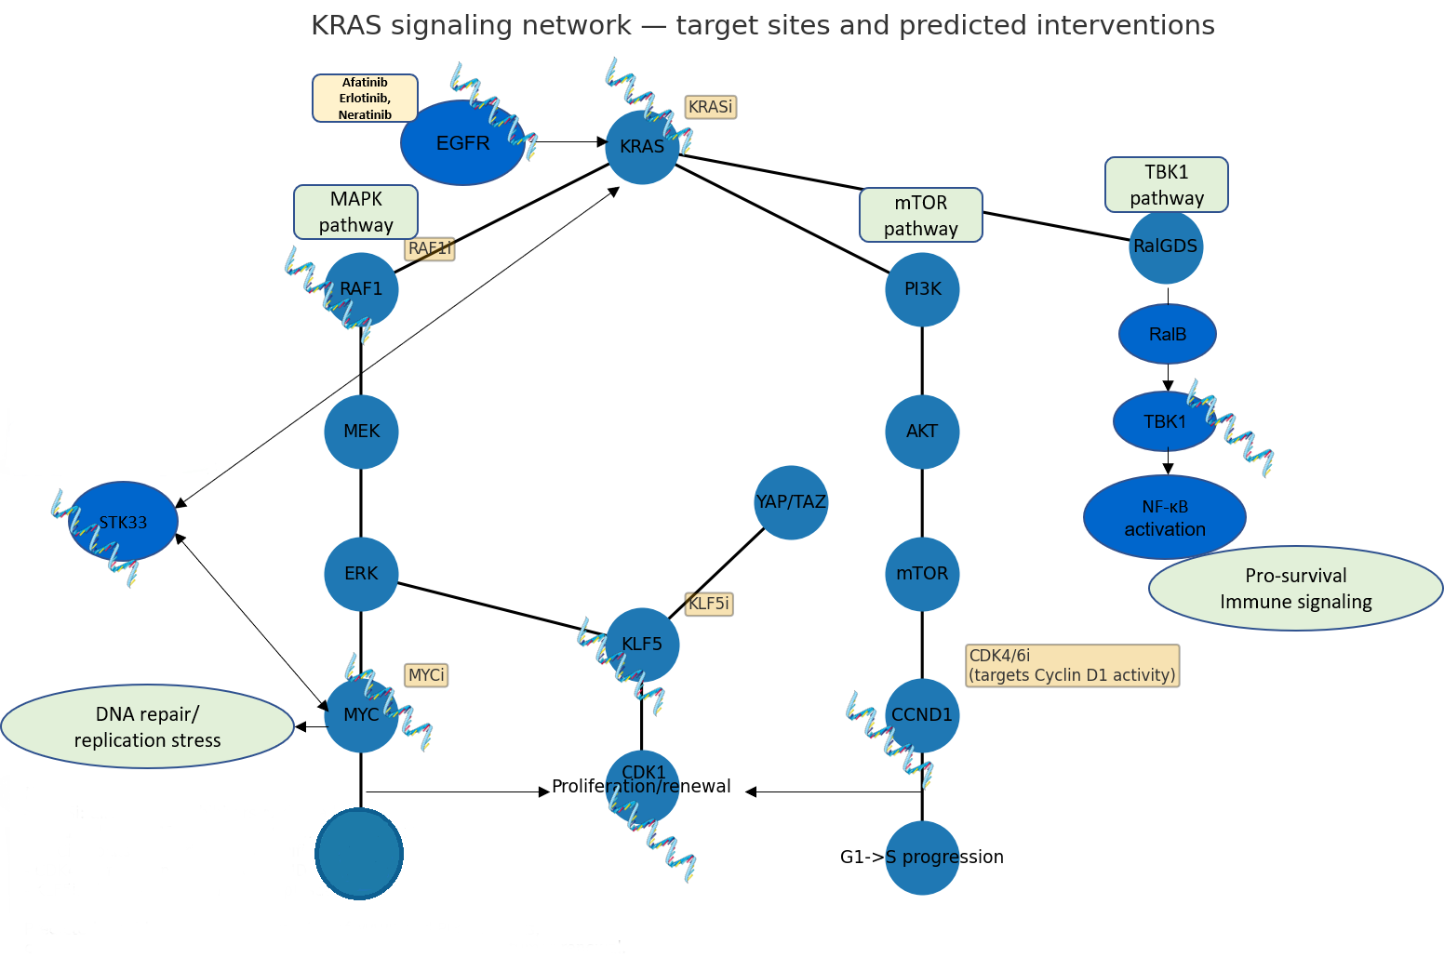
Cytoskeletal and survival maintenance
Cell growth
Neoadjuvant synRNA for cancer treatments

